Slide 1
Chapter2 Discete-Time Signals in Time Domain
The time representation of the discrete- time signals－－sequences
The opetations of discrete-time signals－－time-shift, time reversal, addition, multiplication, difference, convolution
Typic discrete-time signals－－δ[n]，μ[n], sinω₀n，e^{jω0n}（How to determine the periodicity of the latter two sequences）

Slide 2
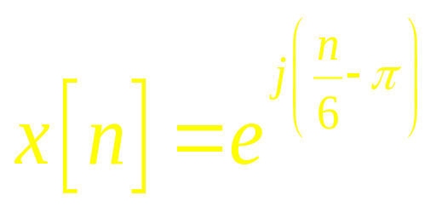
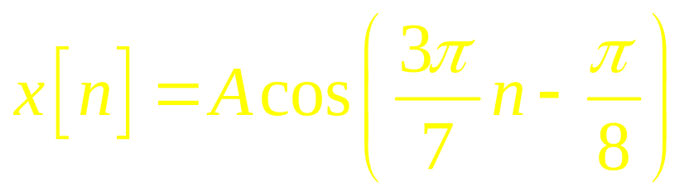
Type I：The periodicity determination
Are the following sequences periodic? If the answer is positive, determine the fundamental period for each sequence.
a) b)
c)
x[n] = 3sin(0.4πn) – 4cos(1.5πn+0.32π)

Slide 3
Chapter 3 DTFT
The definiton of DTFT －－power series with coordinate being e^{jωn}
The properties of DTFT：symmetry relations and theorems
DTFT Computation of typic sequence ，Common DTFT pairs
Sample and recovery
Bandpass sampling

Slide 4
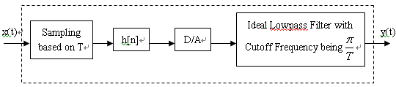
Type II：Signal Sampling
In practice，digital filters are often used to process analog signal. The processing procedure is shown as following figure, where T denotes sampling interval，and satisfies Nyquist Theorem. And we can regard it as an equivalent analog filter.
If the digital filter h[n] is a bandpass filter with the cutoff frequencies ω_{c1}=π/6,ω_{c2}=π/3, 1/T=15kHz，give the cutoff frequency f_{c1} and f_{c2} of the equivalent analog filter.

Slide 5
There is a AM(Amplitude Modulation) signal xa(t)=[1+cos(2π×100t)]cos(2π×600t).
(1) If we use Nyquist sampling to sample the signal without any aliasing, what the minimum sampling rate fT should be ?
(2) Given the sampling rate is 1800Hz, try to sketch the spectrum of the sampled AM signal.
(3) Suppose we use DFT to analyze the signal , with the sampling rate still being 1800Hz. If all the frequency components of this signal must be distinguished（分辨），what the minimal number of sampling points (最小采样点数)should be?

Slide 6
Chapter 4 The Discrete-Time System
The classifications of the discrete-time system：linear，time-invariant，causal，stable
The unit sample response(the impulse response)：simple interconnection schemes
The characteristics of LTI discrete-time system in time domain：input-output realtions，stable requirments etc.

Slide 7
Chapter 4 The Discrete-Time System
Finite dimentional LTI discrete-time system: solution methods
The frequency representaion of LTI discrete-time：frequency response
Phase delay and group delay

Slide 8
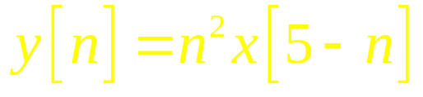
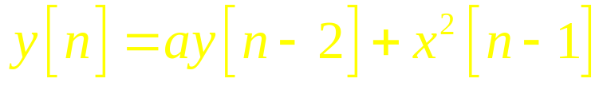
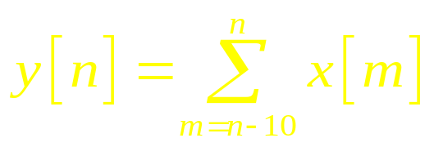
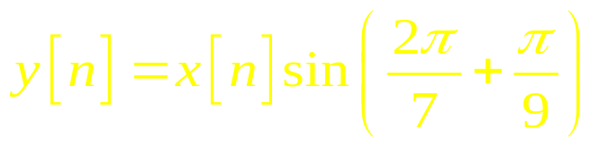
Type III：The determination of system properties
For each of the following discrete-time systems, where y[n] and x[n] are, respectively, the output and the input sequences, determine whether or not each system is (1)linear, (2)causal, (3)stable, (4)shift-invariant:
a) b)
c) d)

Slide 9
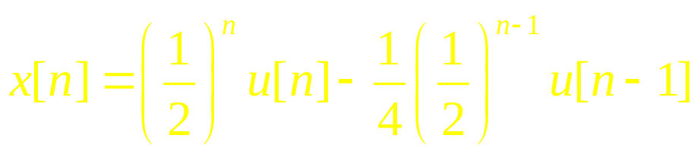
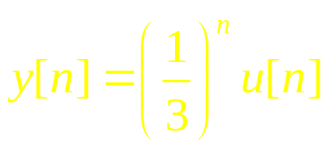
Type IV：The System Response Computation
If a discrete-time LTI system’s input is
The output is
Try to find out the impulse response and frequency response of the system，and give its input-output relation (difference equation).

Slide 10
Chapter 5 DFT&FFT
The definition of DFT－－corresponds to DFS
The properties of DFT
Linear convolution and circular convolution
The engineering computation of DFT－－the DFT computation of real sequences
The idea of FFT－－DIT FFT&DIF FFT

Slide 11
Type V：DTFT，DFT Computations
Let x[n] = δ[n] + δ[n+1],
a) Determine the DTFT of x[n].
b) Determine and sketch the magnitude and phase spectrum of x[n].
c) Calculate the 4-point DFT of x[n].

Slide 12
Type VI：The properties of DTFT、DFT
A 498-point DFT X[k] of a real sequence x[n] has the following samples: X[0]=2, X[11]=7+j3, X[k1]=-2-j, X[112]=3-j0.7, X[k2]=-4+jα, X[249]=3, X[309] = -4 - j2, X[386]=3+j0.7, X[412]=-2+jβ, and X[487]=7-j3. The values of remaining DFT samples are assumed to be zero.
a) Determine the values of the indices k1 and k2.
b) Determine the values of α and β.
c) Determine and x[249].
d) Determine the energy of x[n].

Slide 13
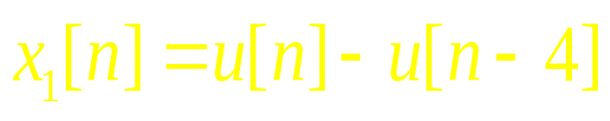
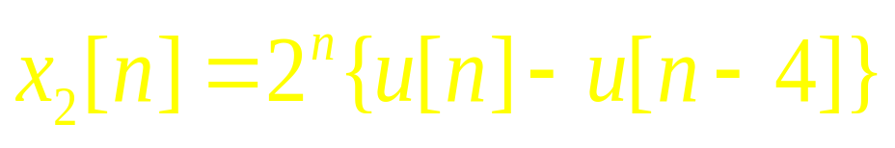

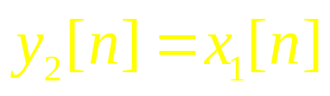
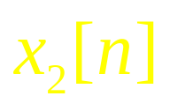
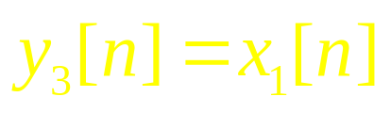
Type VII：Linear convolution and circular convolution
For the following two sequences:
,
Let (linear convolution),
4 (circle convolution), sketch y₁[n], y₂[n].
For L , determine the value of L to guarantee y₁[n]=y₃[n].

Slide 14
Chapter 6 Z-Transform
The definition of ZT
The IZT caculation
The properties of ZT
Tranfer function

